Slide 1


Group 5:
finally:
aka: the third pecha kucha.

Slide 2

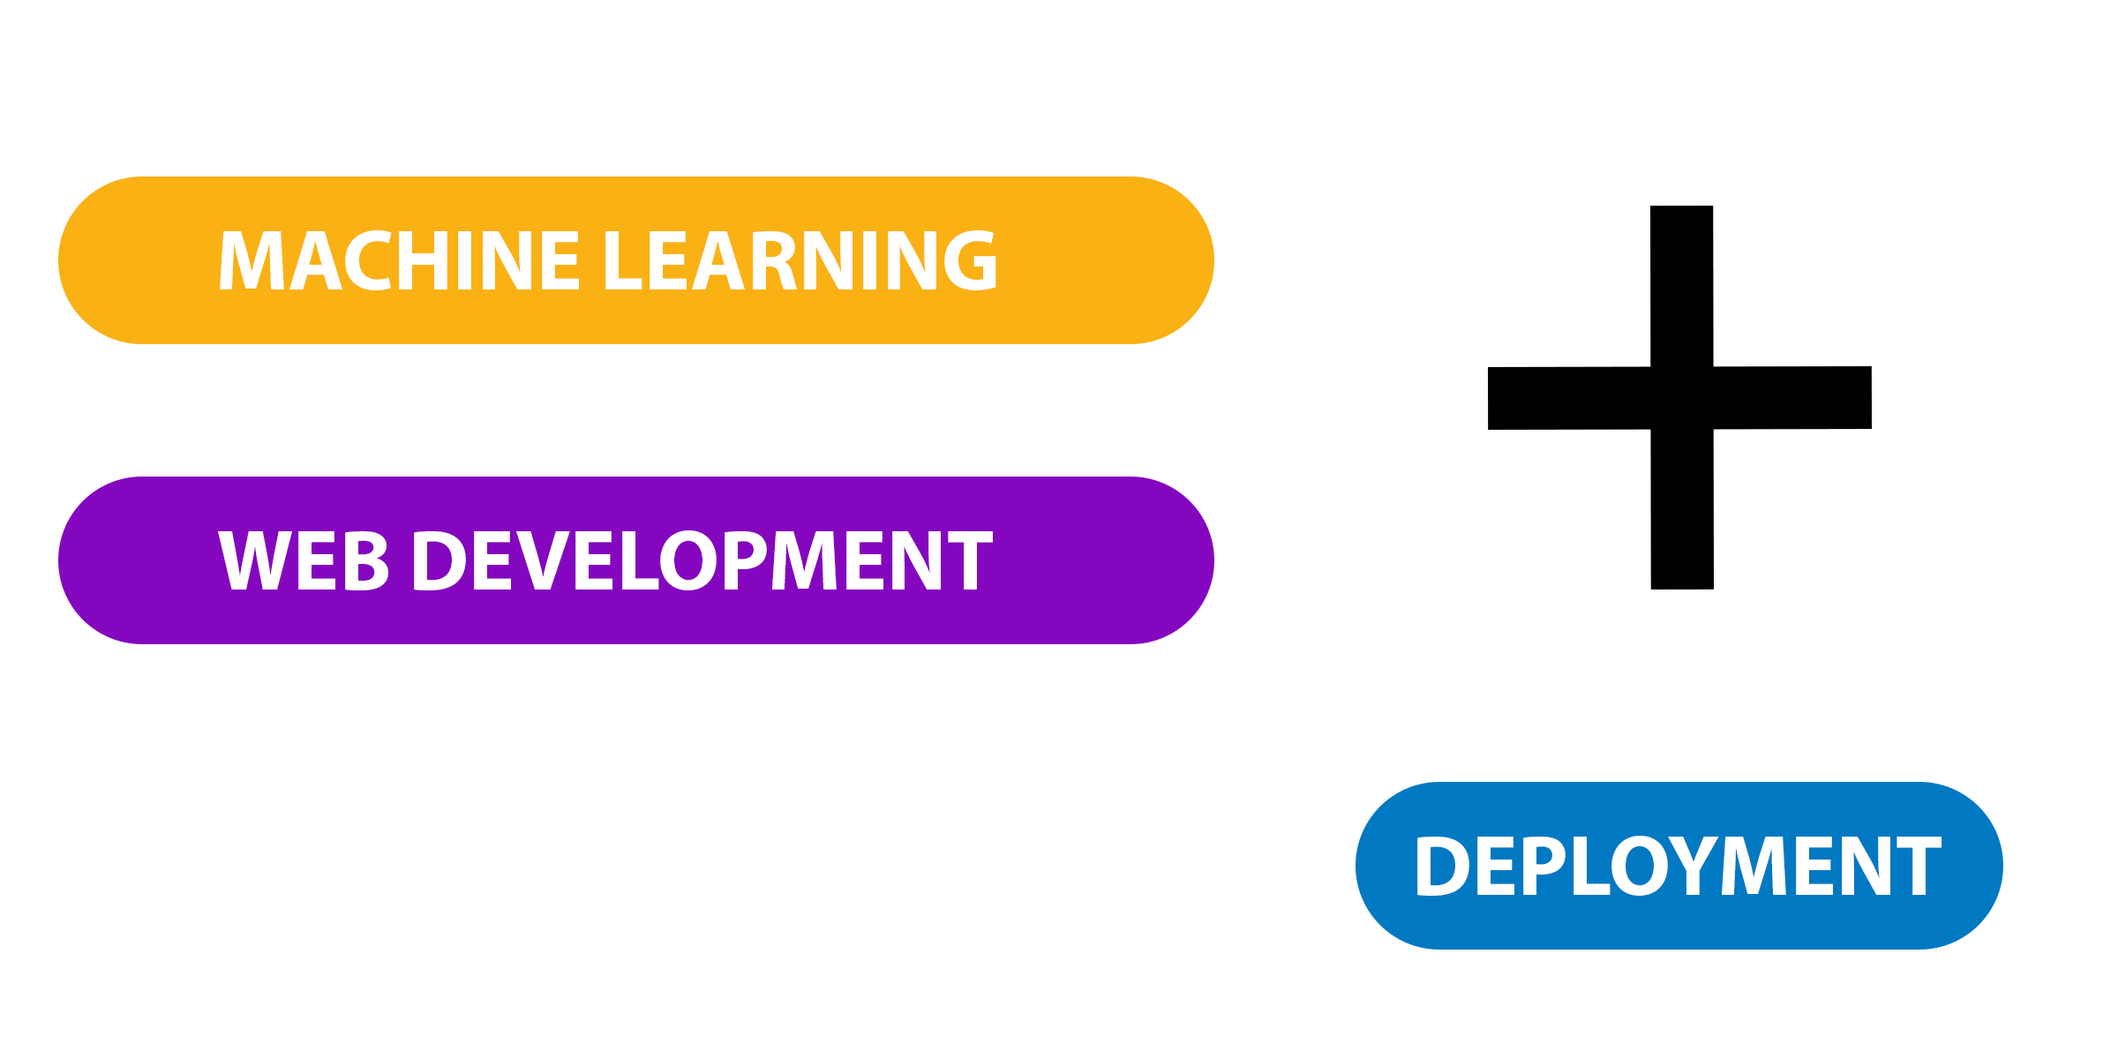

Workflow

Slide 3

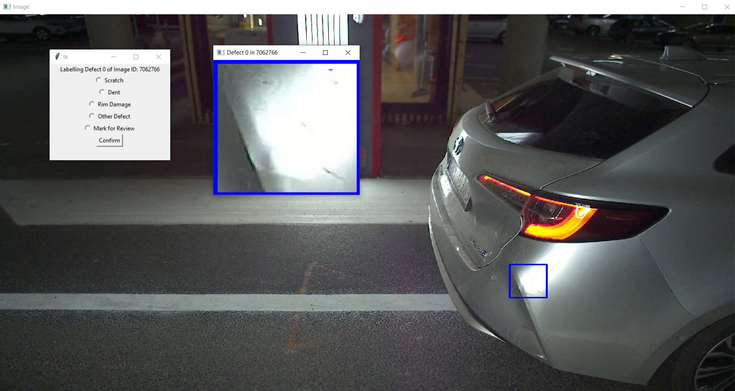
ML Team:
Local Annotator

Slide 4
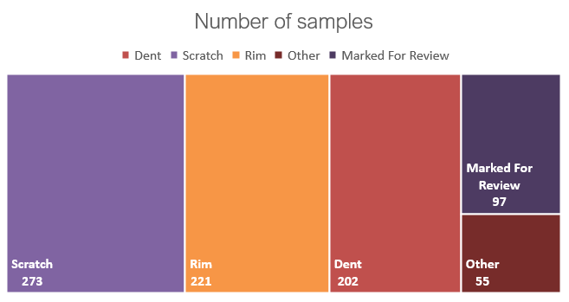
Classification Model: Class distribution

Slide 5
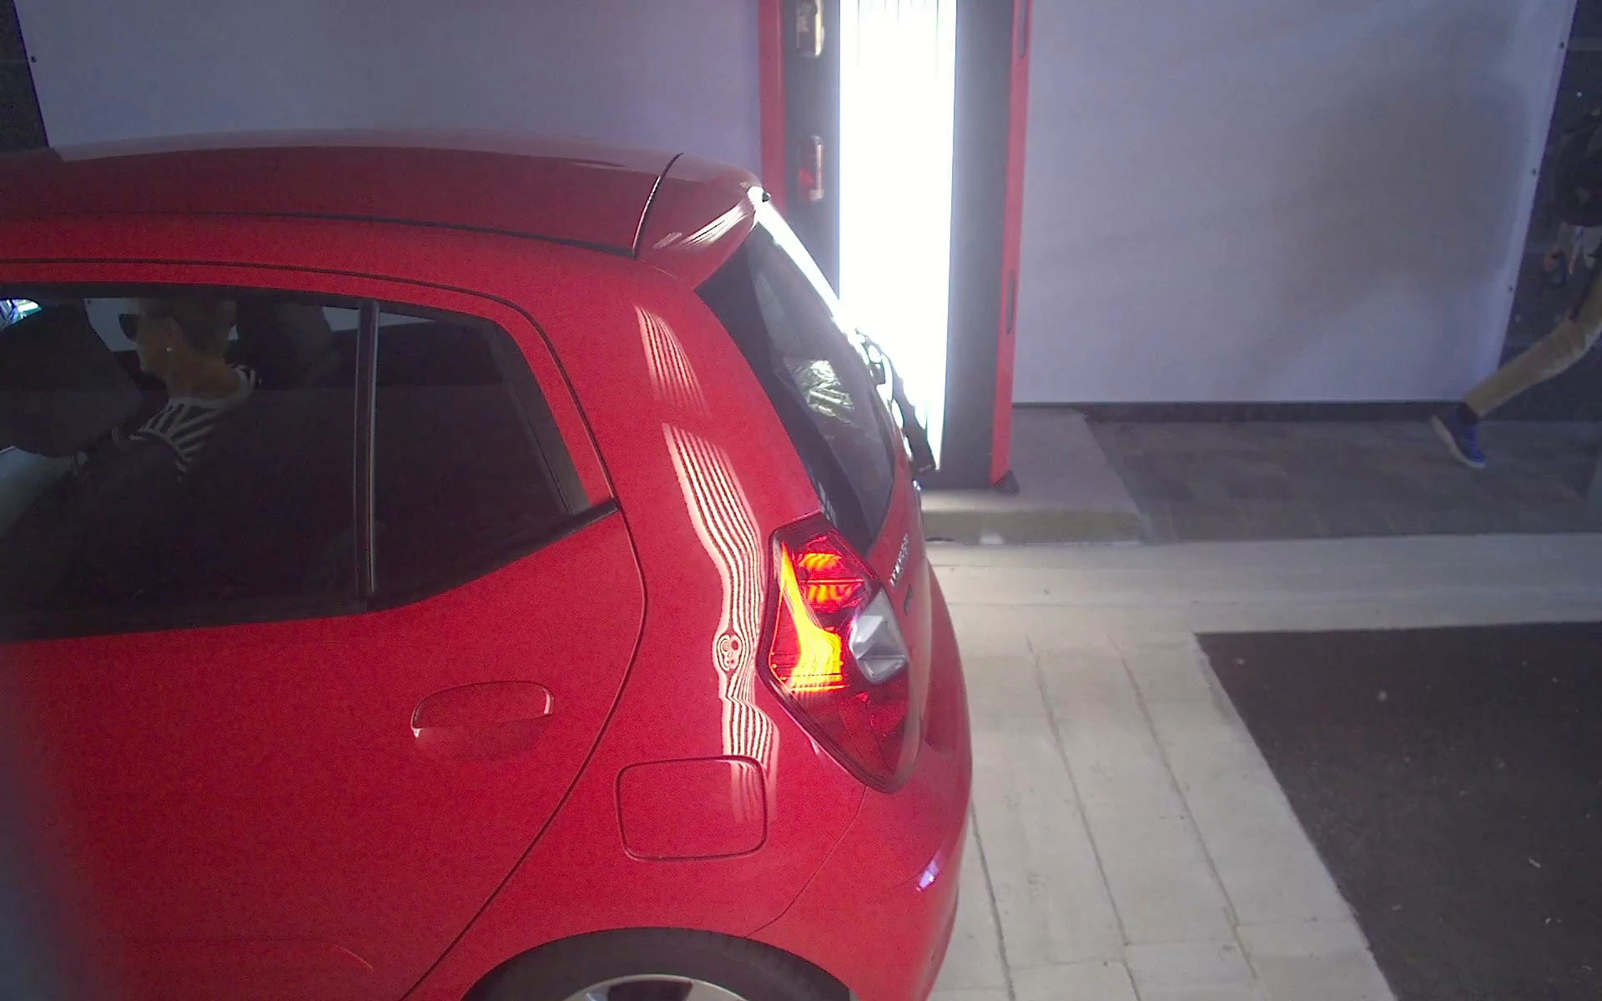
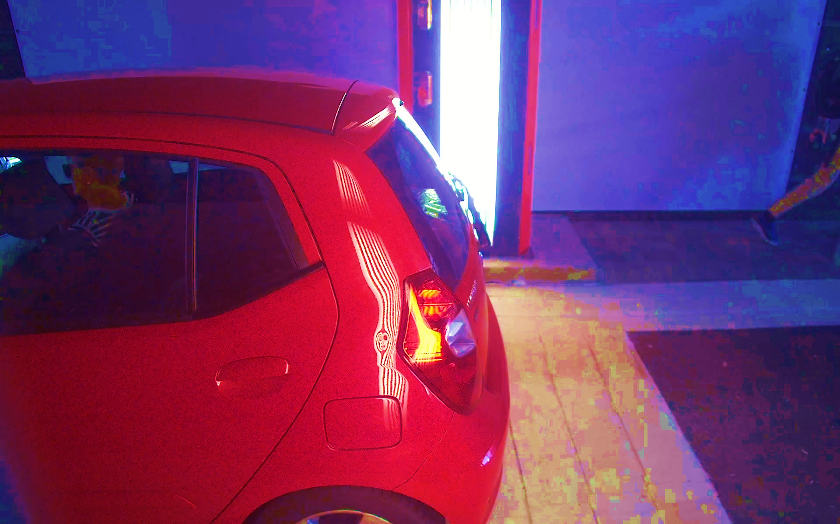
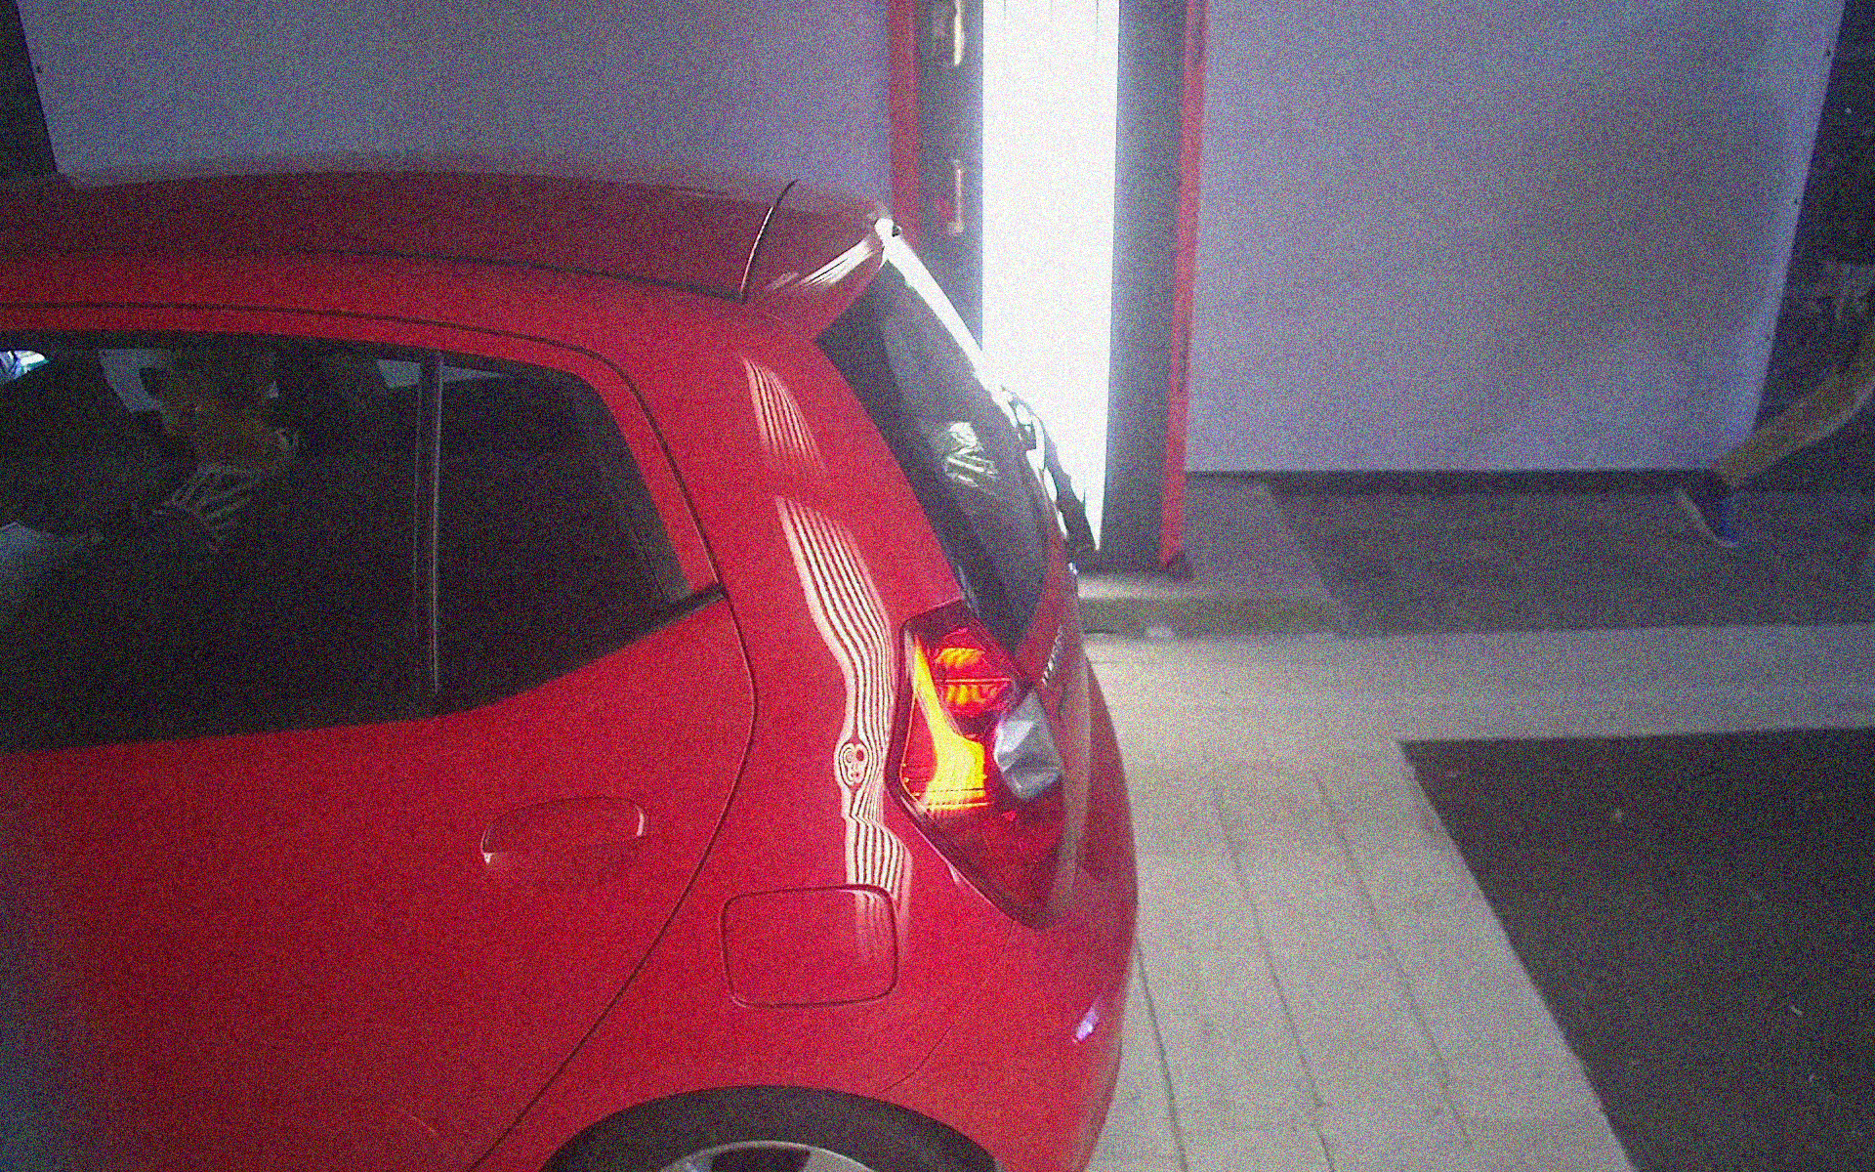
Pre-processing steps
Brightness
Grayscale
Contrast
Flip

Slide 6
Baseline Model: Parameters
Learning Rate
1e-8
Batch-size
32
Epochs
20
Models used
VGG16
Metrics
Accuracy, F1-score, Precision,
Loss function
Categorical_Crossentropy

Slide 7
Baseline Model: Transfer Learning
Pretrained Block 1
Pretrained Block 2
Pretrained Block 3
Pretrained Block 4
Pretrained Block 5
Input
Own Dense Block
Output
Frozen
Frozen
Frozen
Frozen
Retrained
Retrained
Fine-Tuning

Slide 8
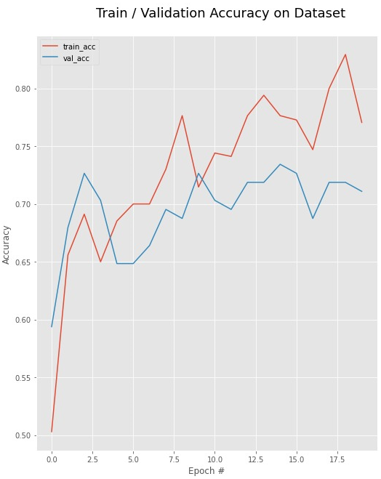
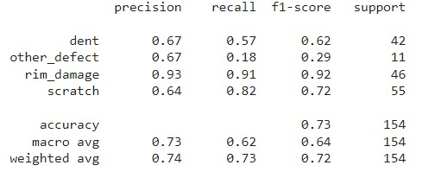
Baseline Model: Results
Results with vgg16 – sticking with this
Classification_report

Slide 9
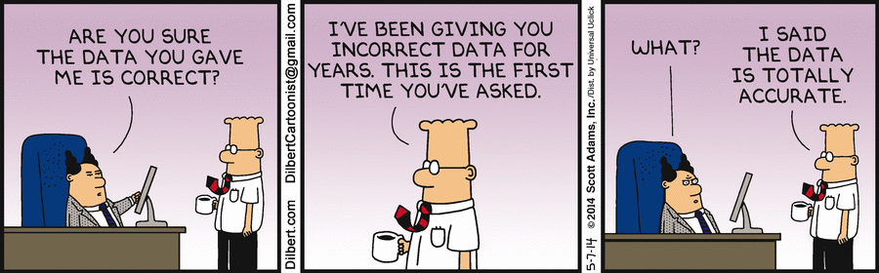
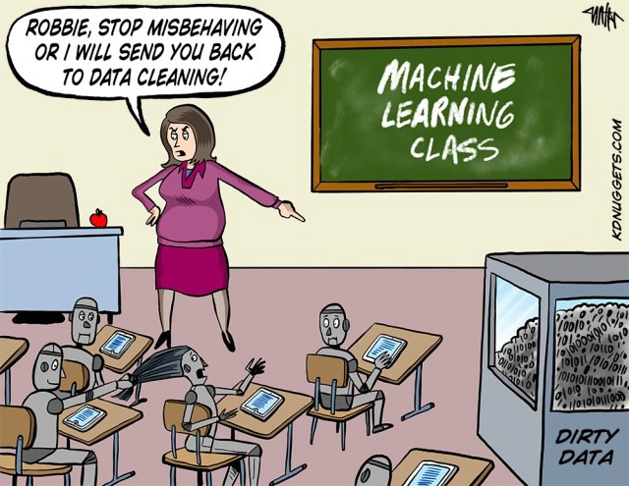
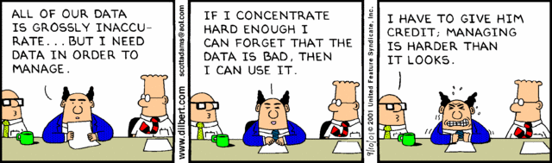
ML Team:
Challenges
Results with vgg16 – sticking with this
2. Scratches and dents look similar
1. Labelling inconsistencies

Slide 10
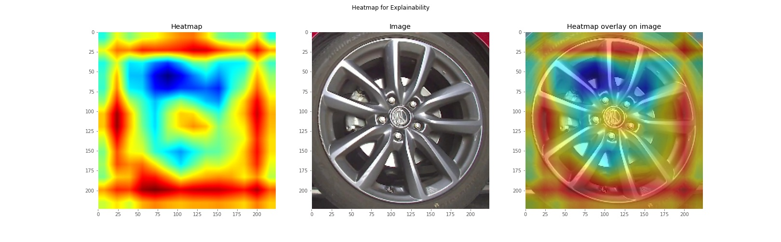
Baseline Model: Explainability
Results with vgg16 – sticking with this

Slide 11
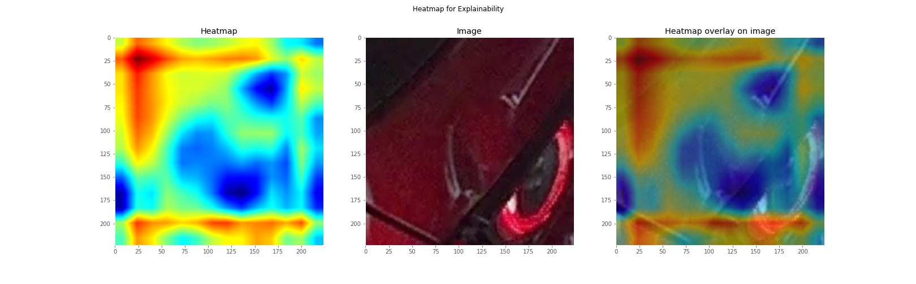
Baseline Model: Explainability
Results with vgg16 – sticking with this

Slide 12
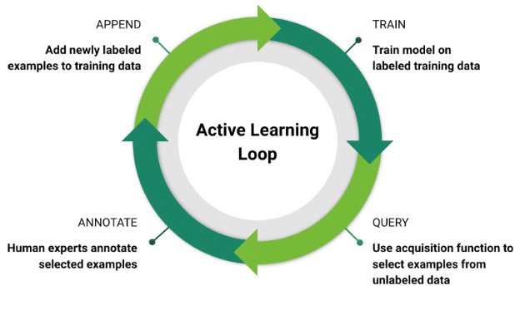
Active learning

Slide 13



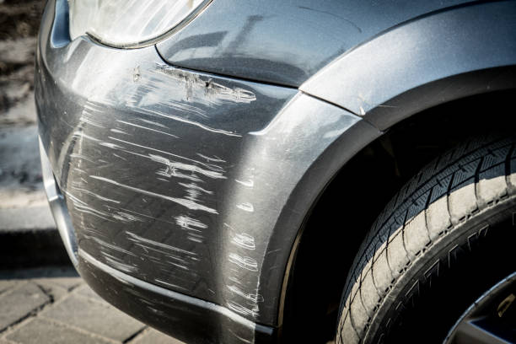




Web: Annotator Workflow

Slide 14
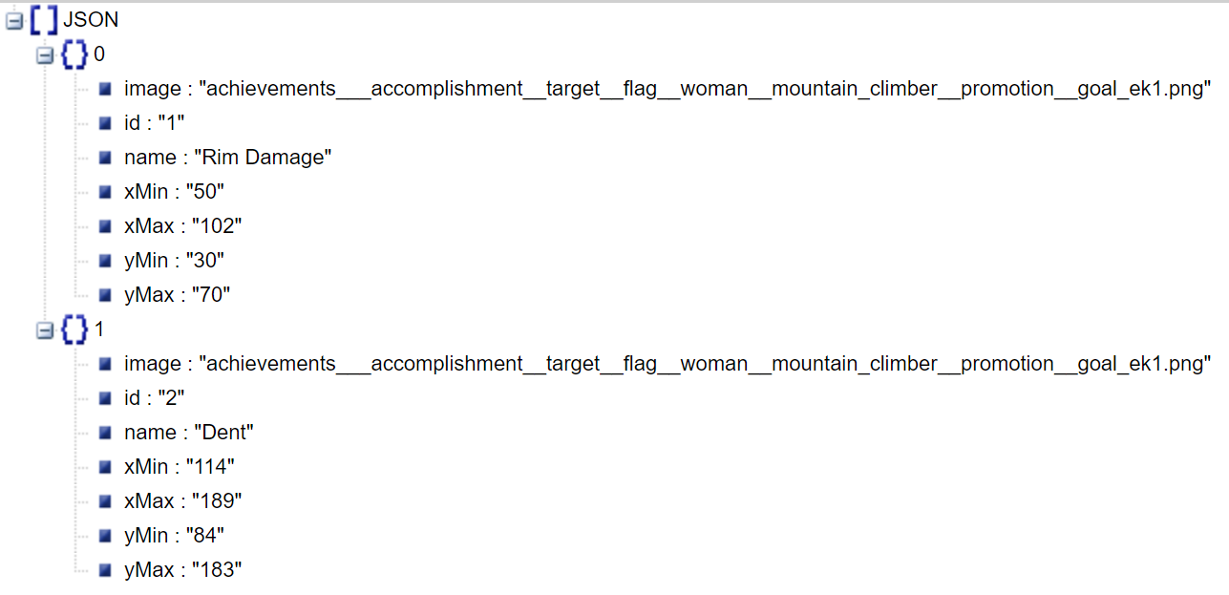

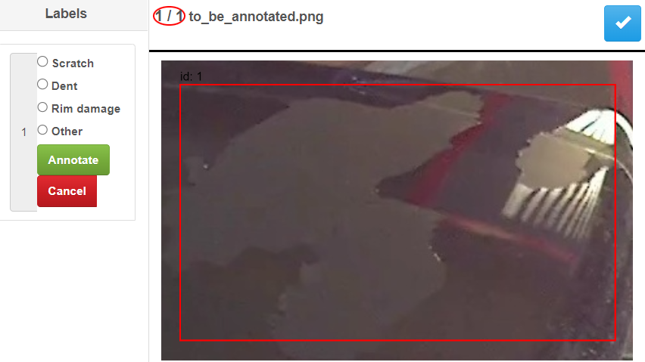
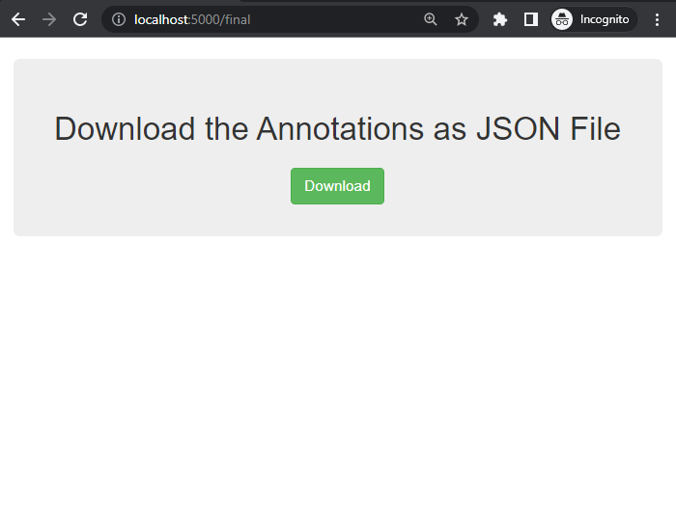
Web: Global Annotator

Slide 15
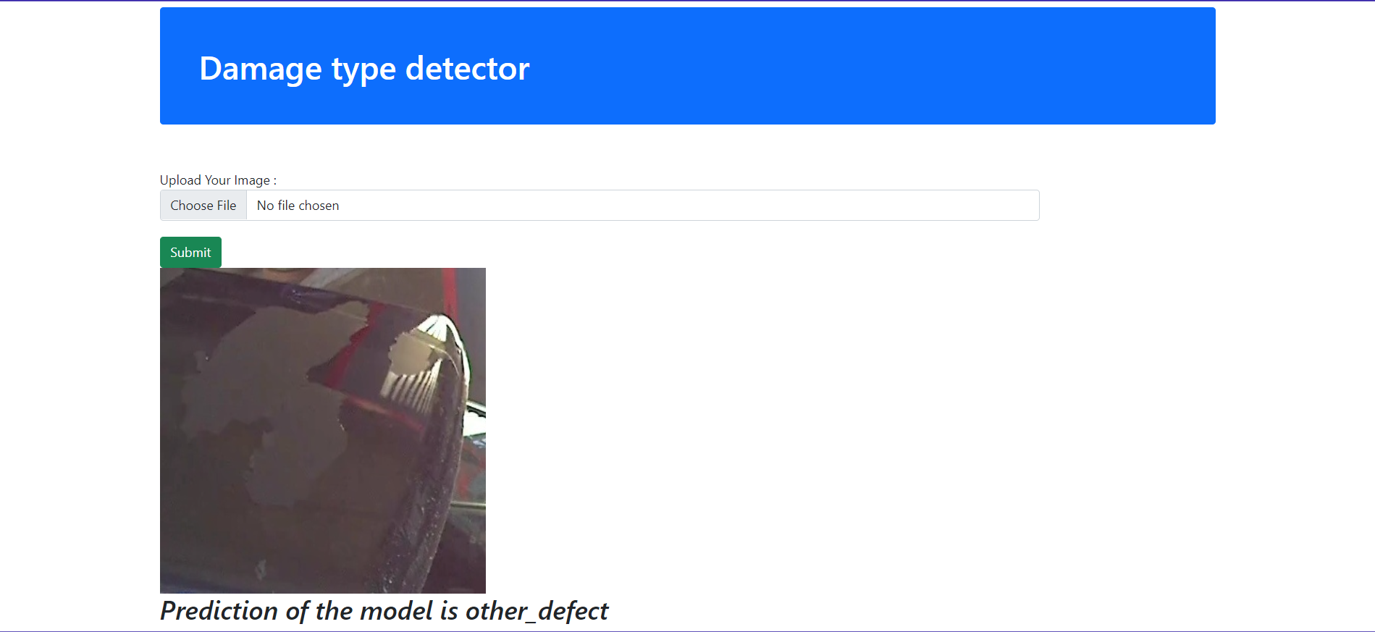
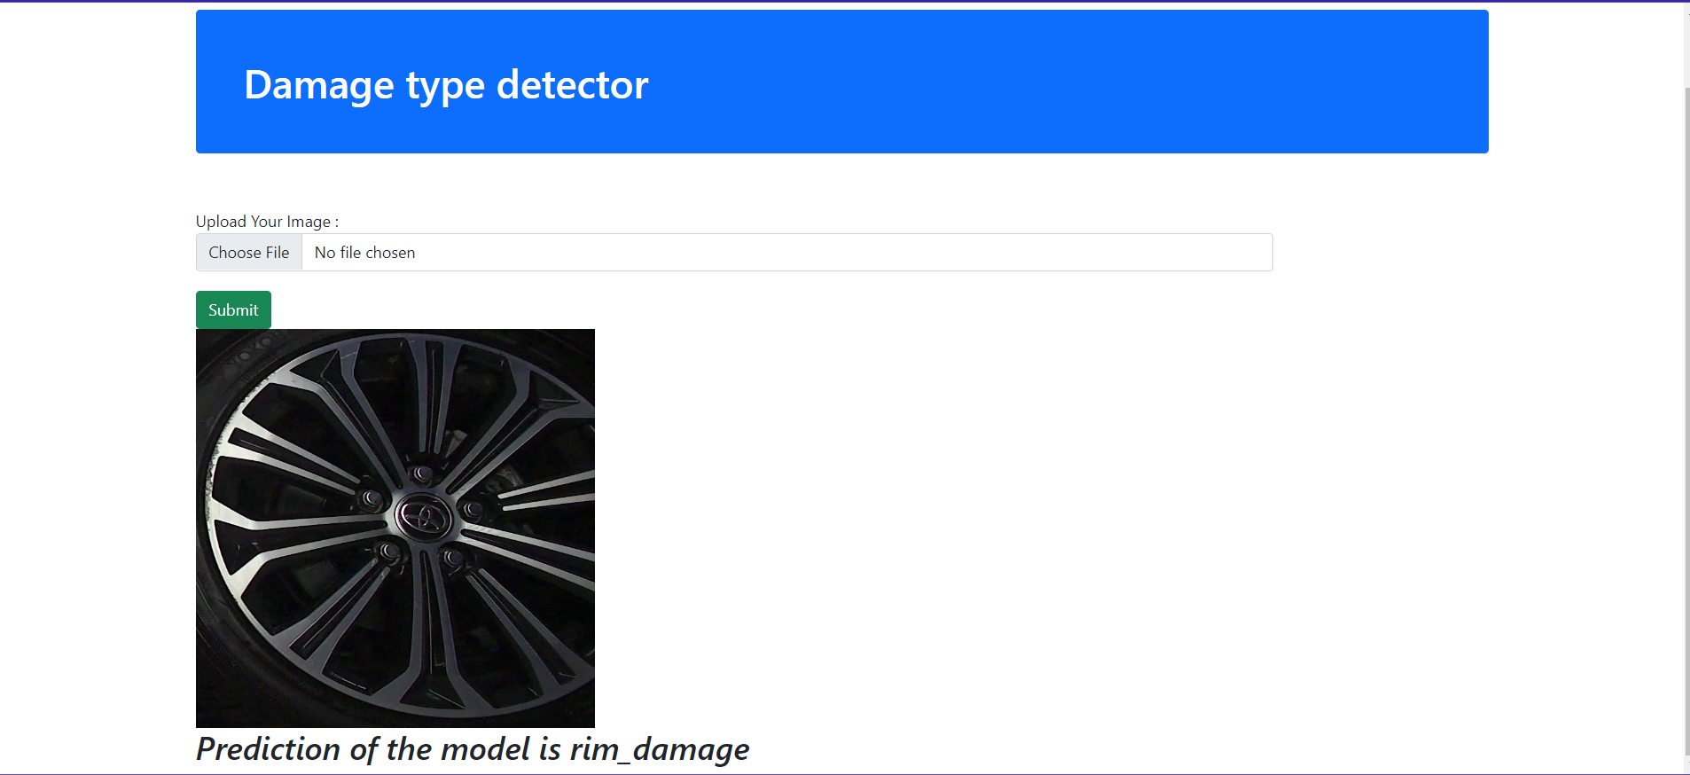
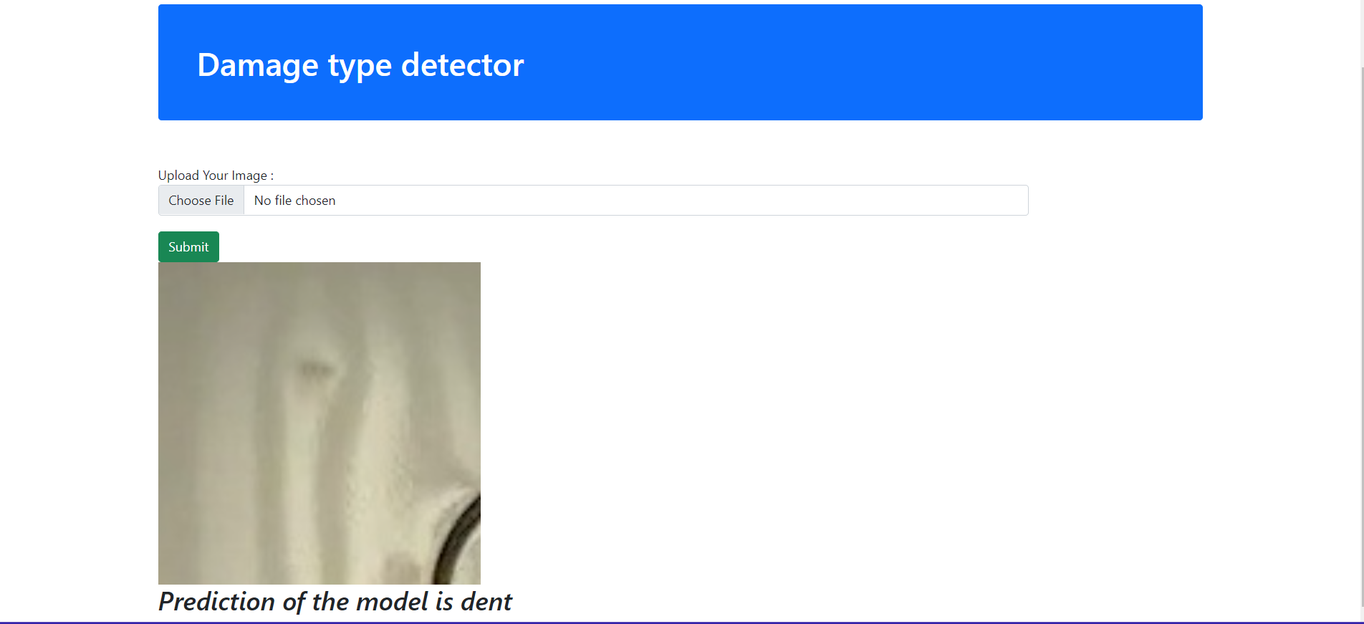
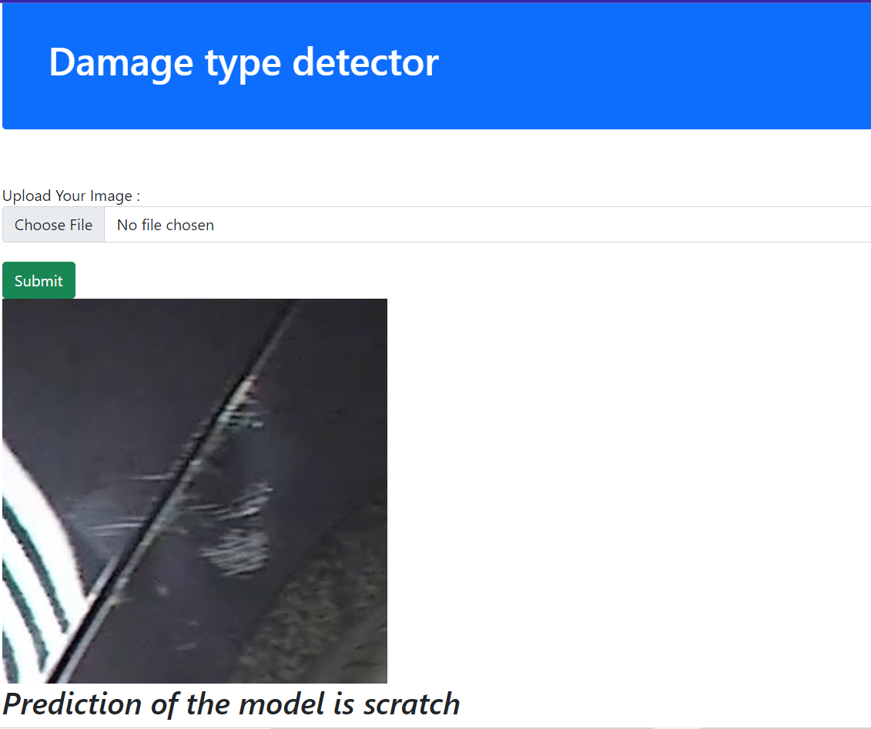
Web: Classifier

Slide 16


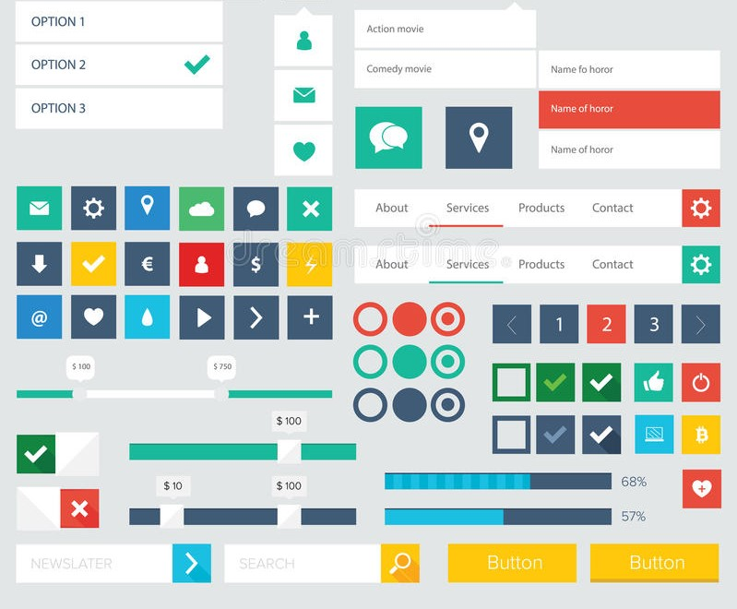
Web: Future Plans

Slide 17

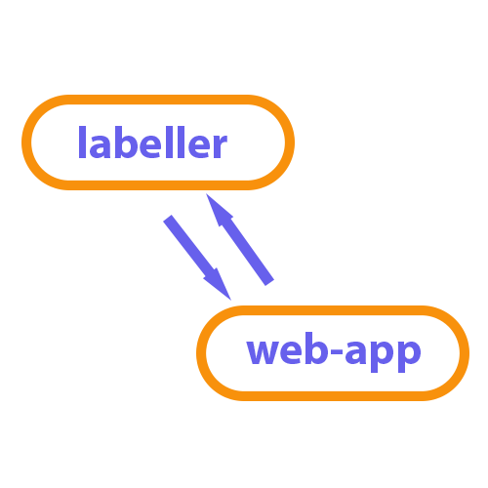




Web: Challenges

Slide 18


Dockerization

Slide 19
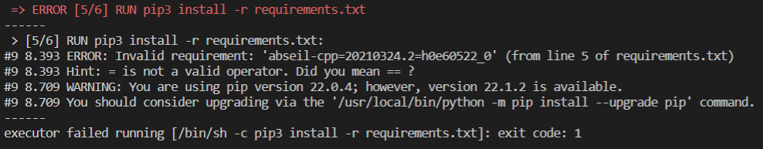
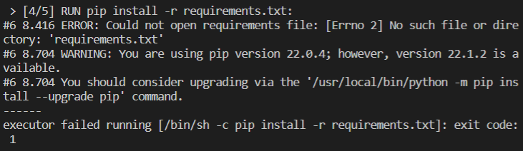
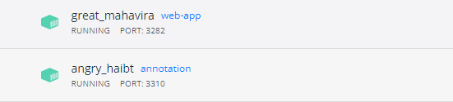
Dockerization: Challenges
requirements.txt
requirements.txt
success

Slide 20



Sprint 2 - Review
Week 4 - 6​
.
ML Team: Baseline Model.​
Deployment team: Assist ML team.​
Web team: Developing UI and API.​
Media team: Pecha Kucha 3

Slide 21
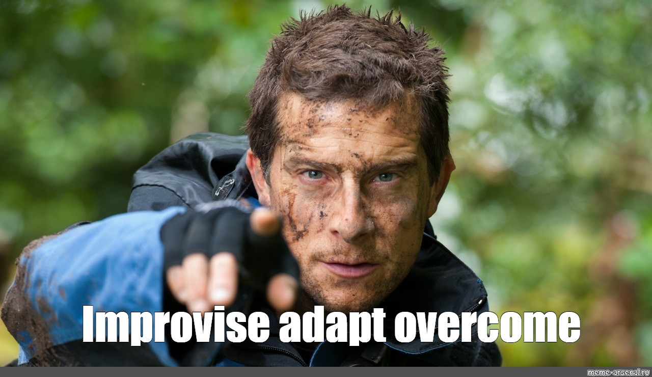
Replanning for next weeks
Make Data Labelling consistent.
Redistribution of team members.
Find an appropriate active learning approach.

